Slide 1

Programming One (csc7050)
Aidan McGowan
Methods

Slide 2
Methods
A Java method is a collection of statements that are grouped together to perform an operation. When you call the System.out.println method, for example, the system actually executes several statements in order to display a message on the console.
Now you will learn how to create your own methods with or without return values, and invoke a method with or without parameters

Slide 3
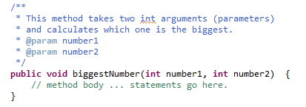
Defining Methods
Example of a method declaration…

Slide 4
Method declaration requirements
The only required elements of a method declaration are the method's return type, name, a pair of parentheses() and a body between braces {}
A method signature is simply the method name and parameter types.

Slide 5
Method format
The format of a method …
visibility [static] return-type method-name (parameter-list) { statements...
}

Slide 6
Method format - visibility
visibility [static] return-type method-name (parameter-list) { statements...
}
The visibility of a method determines whether the method is available to other classes. The options are
  public : Allows any other class to access the method
  private : Hides the method from other classes
  protected : Lets subclasses use the method but hides the
  method from other classes outside the package

Slide 7
Method format - [static]
visibility [static] return-type method-name (parameter-list) { statements...
}
This optional keyword declares that the method is a static method, which means that you can call it without first creating an instance of the class in which it’s defined.

Slide 8
Method format - return-type
visibility [static] return-type method-name (parameter-list) { statements...
}
The return type, indicates whether the method returns a value when it is called — and if so, what type the value is e.g. int, double, String etc. If the method doesn’t return a value, specify void.
If you specify a return type other than void, the method must end with a return statement that returns a value of the correct type.

Slide 9
Method format - method-name
visibility [static] return-type method-name (parameter-list) { statements...
}
The rules for making up method names are similar to variables : Use any combination of letters and numbers, but start with a letter (lower case) and make it meaningful.

Slide 10
Method format - parameter-list
visibility [static] return-type method-name (parameter-list) { statements...
}
You can pass one or more values to a method by listing the values in parentheses following the method name. The parameter list in the method declaration lets Java know what types of parameters a method should expect to receive and provides names so that the statements in the method’s body can access the parameters as local variables.
If the method doesn’t accept parameters, you must still code the parentheses that surround the parameter list. You just leave the parentheses empty.

Slide 11
Method format - statements
visibility [static] return-type method-name (parameter-list) { statements...
}
One or more Java statements that comprise the method body, enclosed in a set of braces. The method body requires you to use the braces even if the body consists of only one statement.

Slide 12

Declaration in action…
visibility
return type
method name
Parameter list
statements

Slide 13

Main method
In Java, within an application you usually have a method named main in at least one class within a package.
It is the start point for an application.
The runtime system starts by calling the specified class's main() method. The main() method then calls all the other methods required to run your application.
It is possible to start the application from a command line and provide arguments (although we have letting the IDE do this for us so far !)

Slide 14
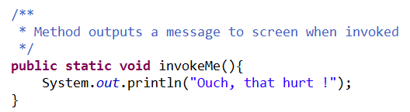
Simple method
method name
Javadoc comment
method body

Slide 15
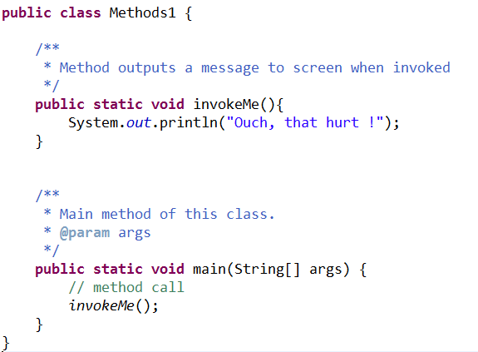
Invoking the method
Method invoked from within the same class. We can call this method directly because it is declared as static

Slide 16
Method output…

Slide 17
Method - exercises
Create a method that when invoked will write your name to the screen …

Slide 18
Method - exercises
Update the method so that when invoked will write your name to the screen 10 times…

Slide 19

Method - exercises
Write a method that will calculate which year you will turn 100.
To get the current year ..
Hardcode your age as a variable of type int in the method
Notes:
public static void yearTurn100(){
int currentAge, currentYear, yearTurning100;
currentAge = 30;
yearTurning100 = 0;
currentYear = java.util.Calendar.getInstance().get(java.util.Calendar.YEAR);
yearTurning100 = 100 - currentAge + currentYear;
System.out.println("Year turning 100 is : "+yearTurning100);
}

Slide 20

Methods .. Passing values
The last method is good to a point !
It only works for you or anyone that is the same age as you.
It would be better to be able to pass the age into the method and then it would become a lot more useful.
Passing a value into a method is called parameter passing

